Slide 1
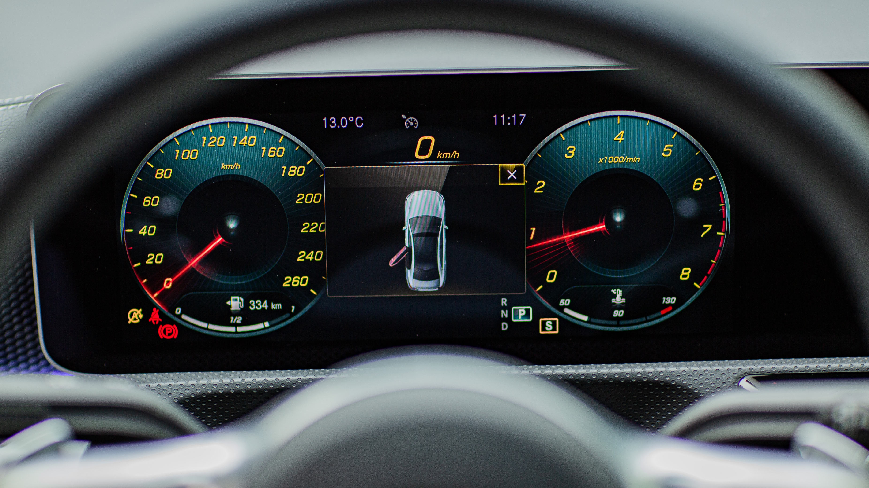
Detection of blind spot
VISION GUARD
A Low-Cost Solution for Safer Overtaking
Institute: KIET
Date: May 31, 2025

Slide 2





Team Members
11696 Muhammad Abad Khan
E-mail: abadkhan5438@gmail.com
Expertise: Cyber Security, Networking, UI/UX
11965 Sadia Naz
E-mail: sadiaarif.khan05@gmail.com
Expertise: Cyber Security, Artificial Intelligence, Database
13619 Tooba Anwer
E-mail: toobaanwer32@gmail.com
Expertise: Front-end Development Using Html CSS JavaScript
64822 Warisha Jamal
E-mail: warishajamalsai@gmail.com
Expertise: Python Developer, Artificial Intelligence

Slide 3
1
Introduction
7
Components
2
Problem Statement
8
Similar Applications
Table of contents
3
Motivation
9
Project Features
CONTENTS
4
Project Objective
10
Testing & Validation
5
11
Work Flow
Proposed Solution
6
Tools & Technology
12
Conclusion

Slide 4
01
Introduction

Slide 5
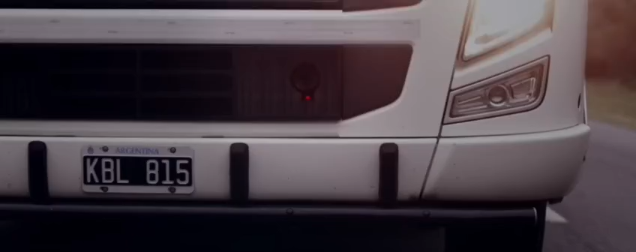
Introduction
The goal of a Vision Guard is a smart safety system designed to reduce road accidents caused by blind spots on overtaking scenarios. It helps drivers to make safer decisions for overtaking by detecting too close vehicles, estimating their speed, and showing real time alerts on a screen.

Slide 6
02
Problem Statement

Slide 7
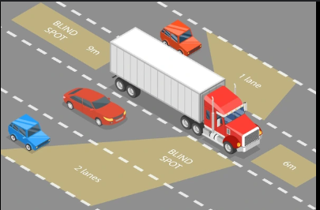
.
.
2
Problem Statement
Road accidents are a major cause of death due to careless overtaking, blind spots, and poor visibility.
Drivers behind large trucks can't see ahead clearly, leading to poor overtaking decisions.
The absence of real time alerts increases accident risks.
Most safety systems are costly and not suitable for low budget vehicles.

Slide 8
03
Motivation

Slide 9
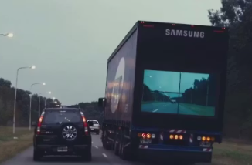
.
.
3
Motivation
Inspired by Samsung’s Safety Truck concept, which uses a front-facing camera on trucks to stream the front view onto a screen placed at the back of the truck. This helps drivers behind the truck see what’s ahead and decide safely when to overtake.

Slide 10
04
Project Objective

Slide 11
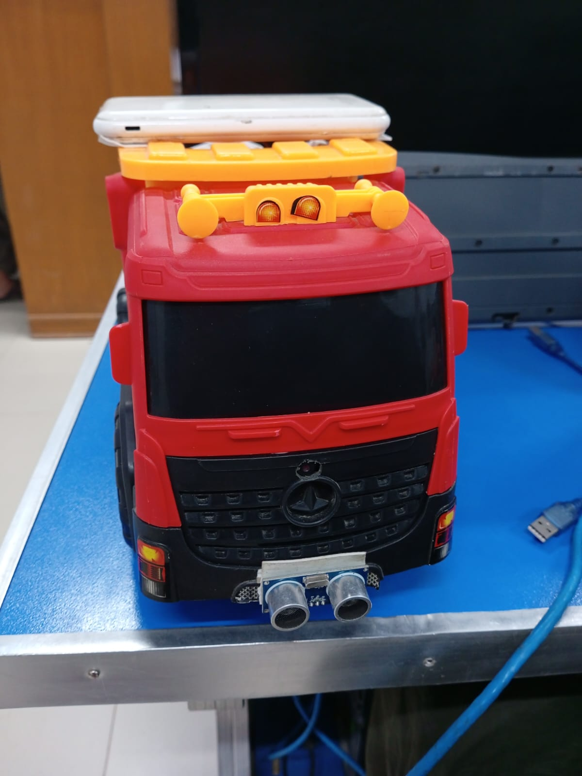
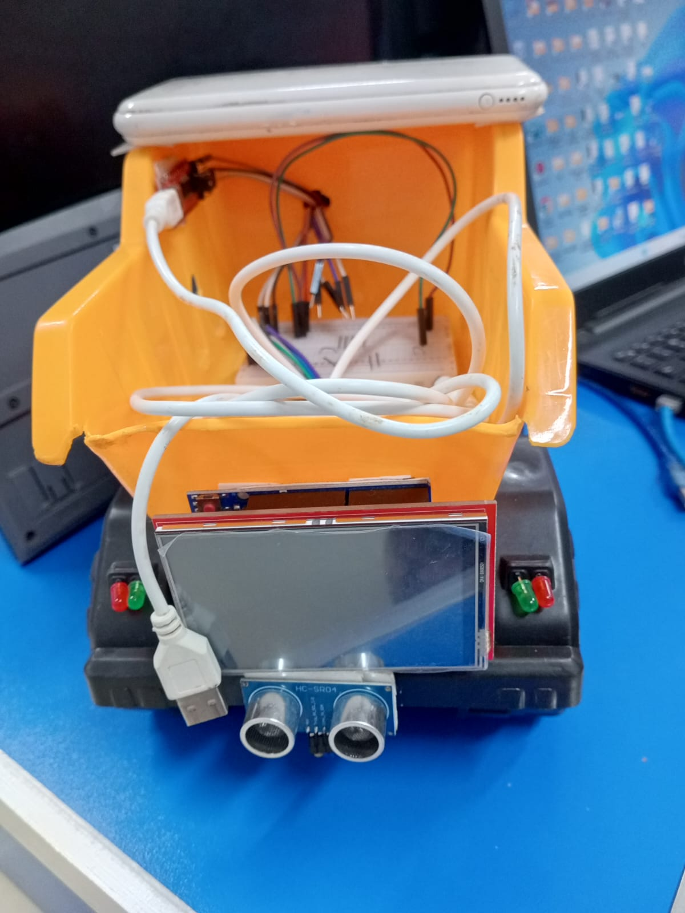
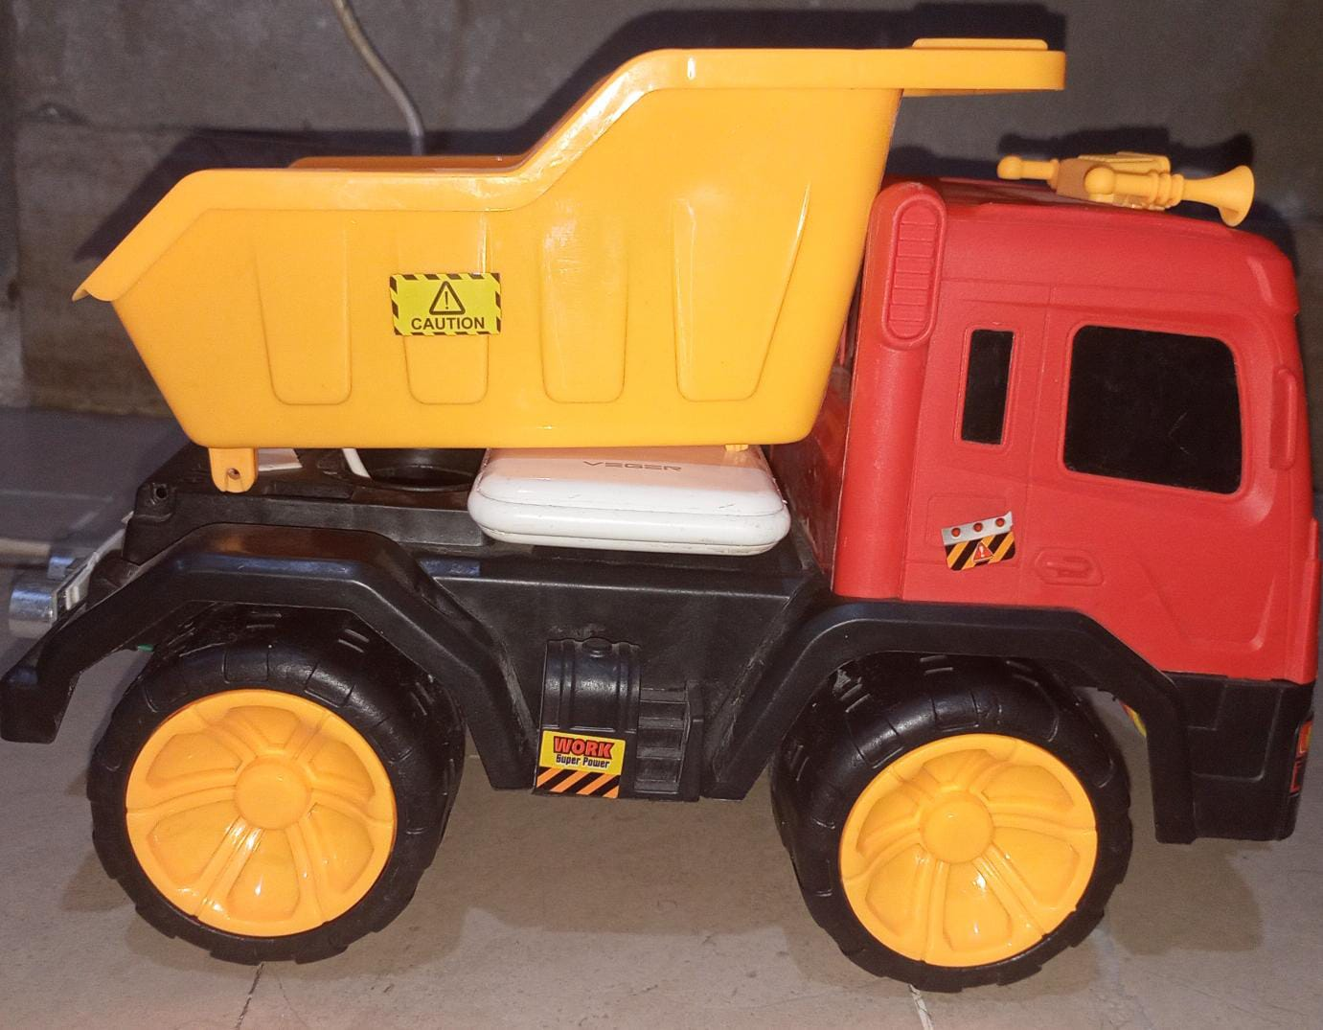
4
Project Objective
What we aim to solve?
Reduce accidents from blind spots and risky overtaking.
Improve road safety through better driver awareness.
Provide real-time visibility and alerts to following vehicles.
Enable data logging for driving analysis.
Solve these problems using an affordable and efficient system.

Slide 12
05
Proposed Solution

Slide 13
5
Proposed Solution
How we solved it
Use affordable hardware (camera, sensors, LCD, LEDs) for a smart safety system that can be easily installed on any vehicle.
Stream real time front road video to assist in overtaking decisions.
Detect nearby vehicles and give visual & audio alerts using LED indicators.
Reduce accidents by improving visibility and awareness.
Log vehicle & driving data on a web dashboard.

Slide 14
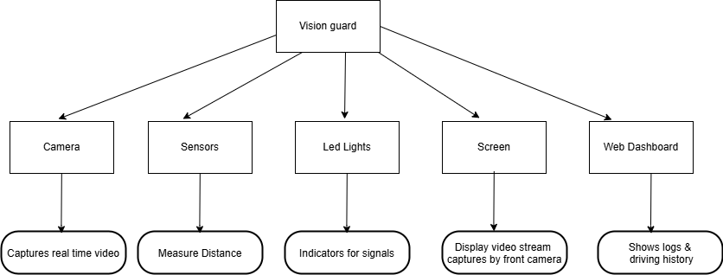
5
Proposed Solution

Slide 15
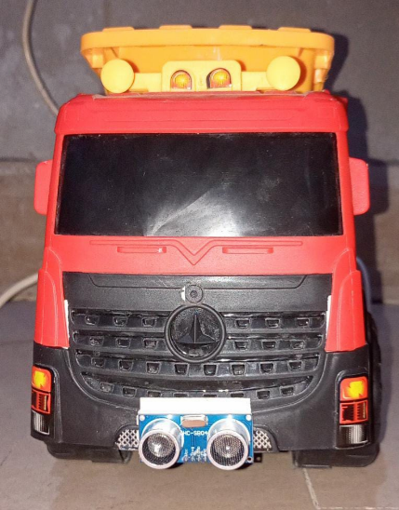
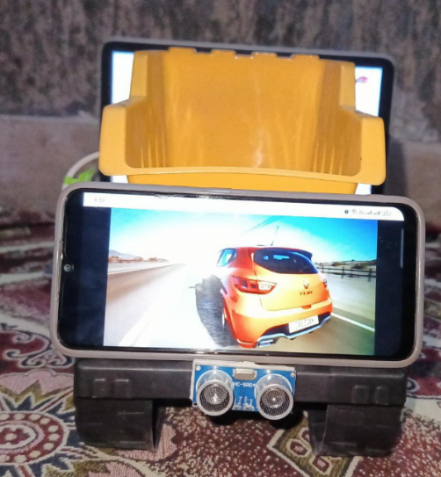
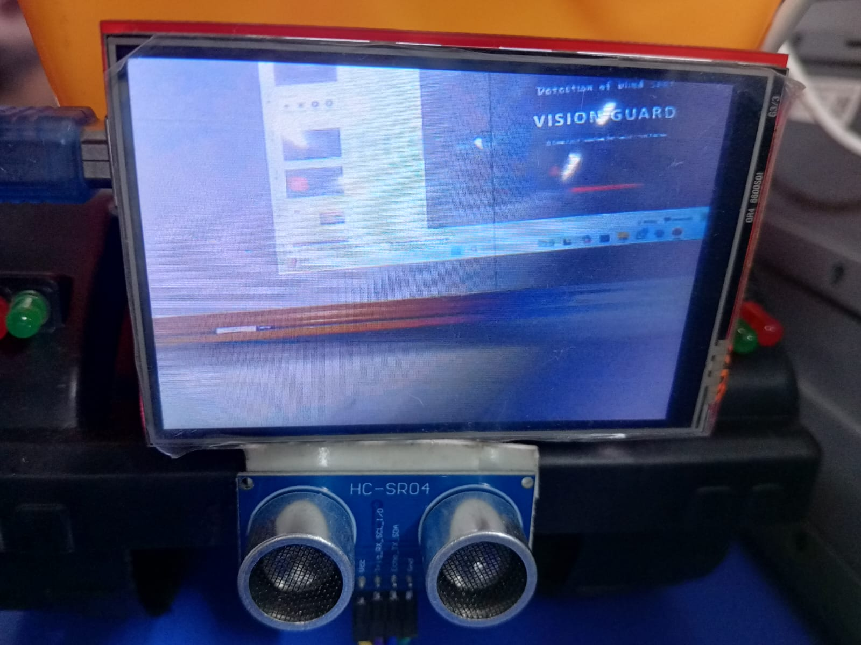
5
Proposed Solution
FRONT VIEW
BACK VIEW

Slide 16
06
Tools & Technologies

Slide 17
.
6
Tools & Technologies
Hardware:
Camera, Ultrasonic Sensors, Node MCU, Buzzers, Arduino UNO, LCD(ILI-9486), LED lights
Software:
Python, YOLO 3, OpenCV, Arduino IDE
Techniques:
Image Processing, Model Training, Roboflow

Slide 18
07
Components

Slide 19
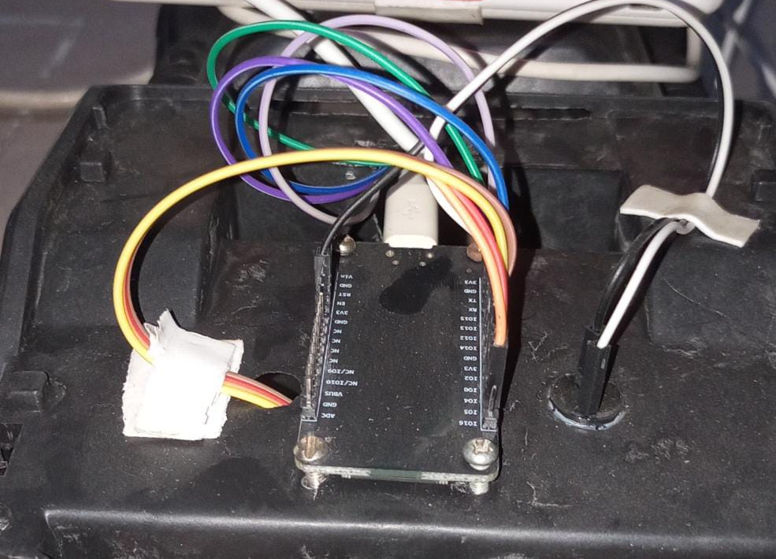
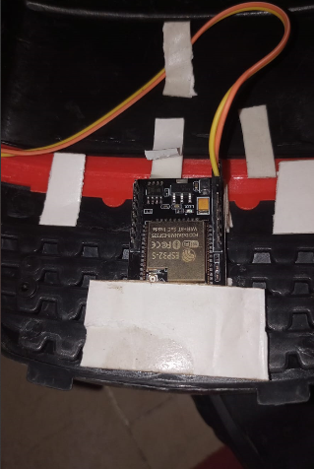
.
7
Components
Node MCU Connects buzzer and ultrasonic sensor (front and back)
ESP 32 Camera Use for streaming over internet.

Slide 20
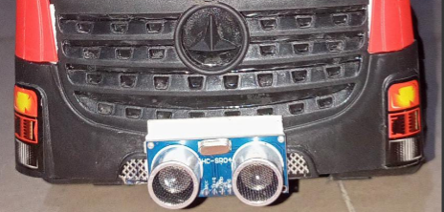
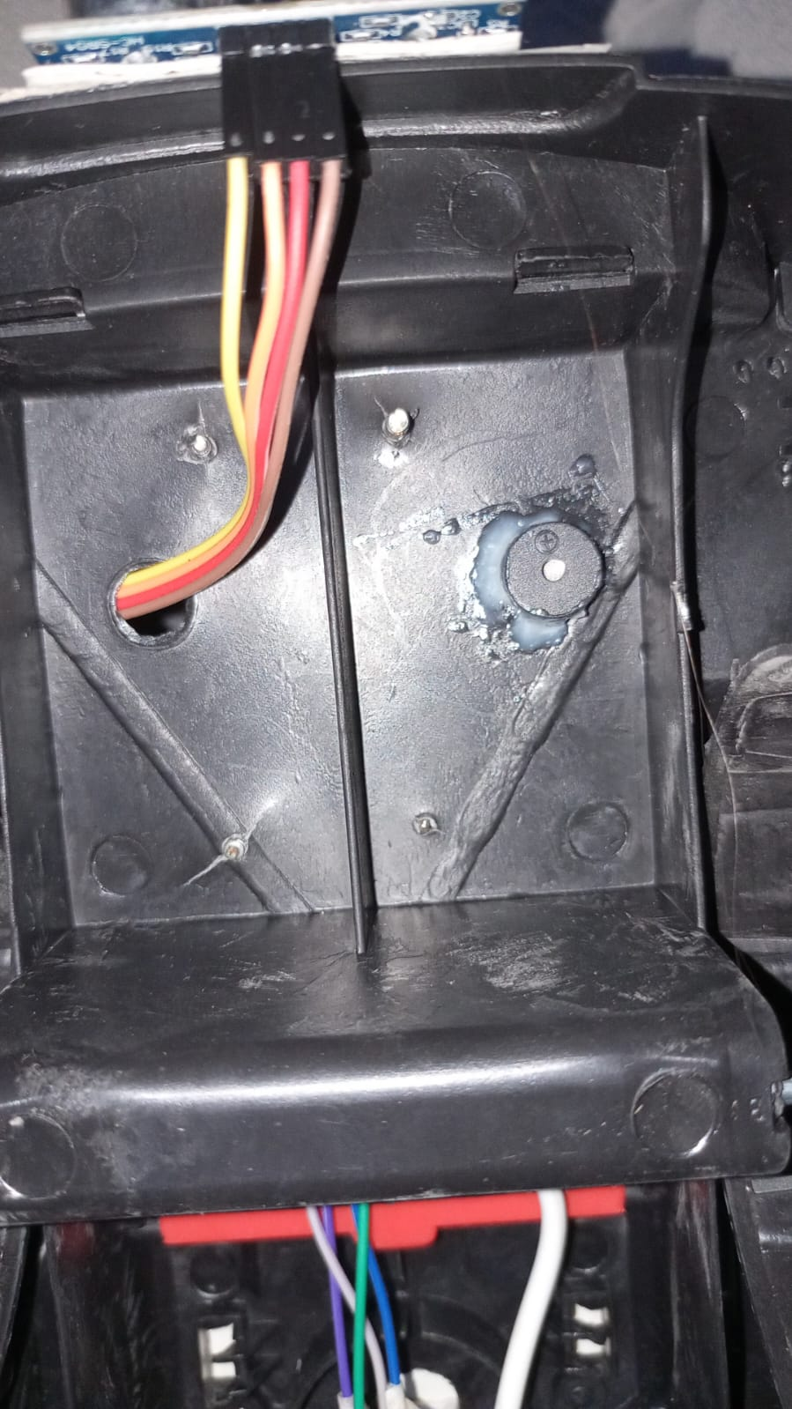
.
7
Components
Ultrasonic sensor Use to calculate distance.
Buzzer Generate alert if distance is less than 50cm.

Slide 21
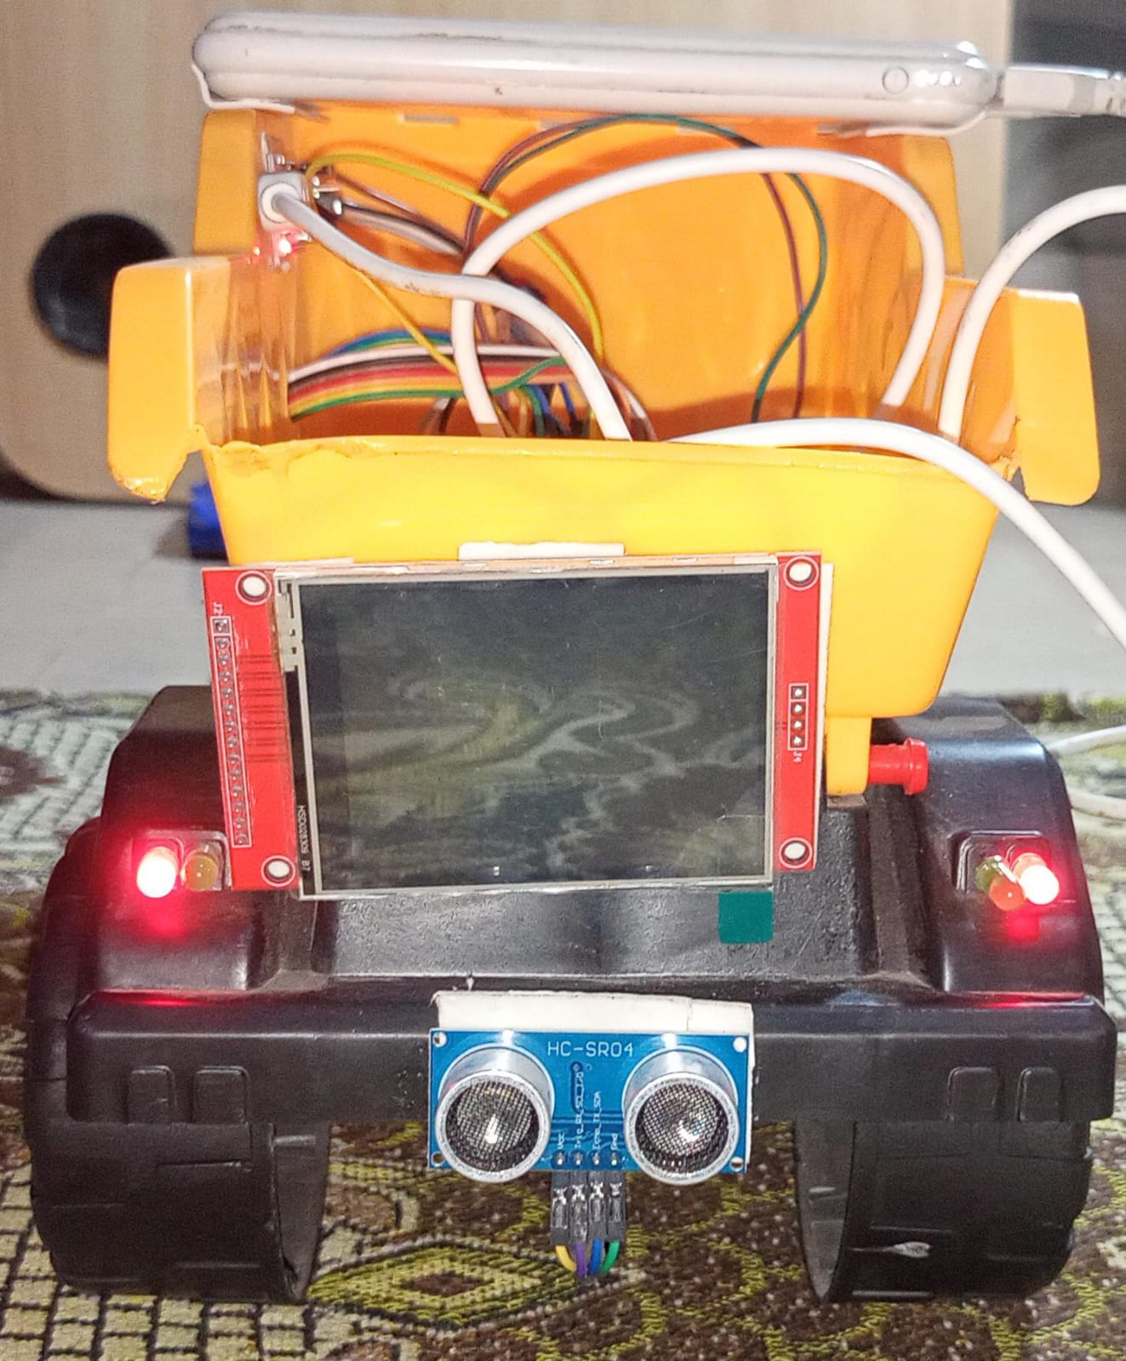
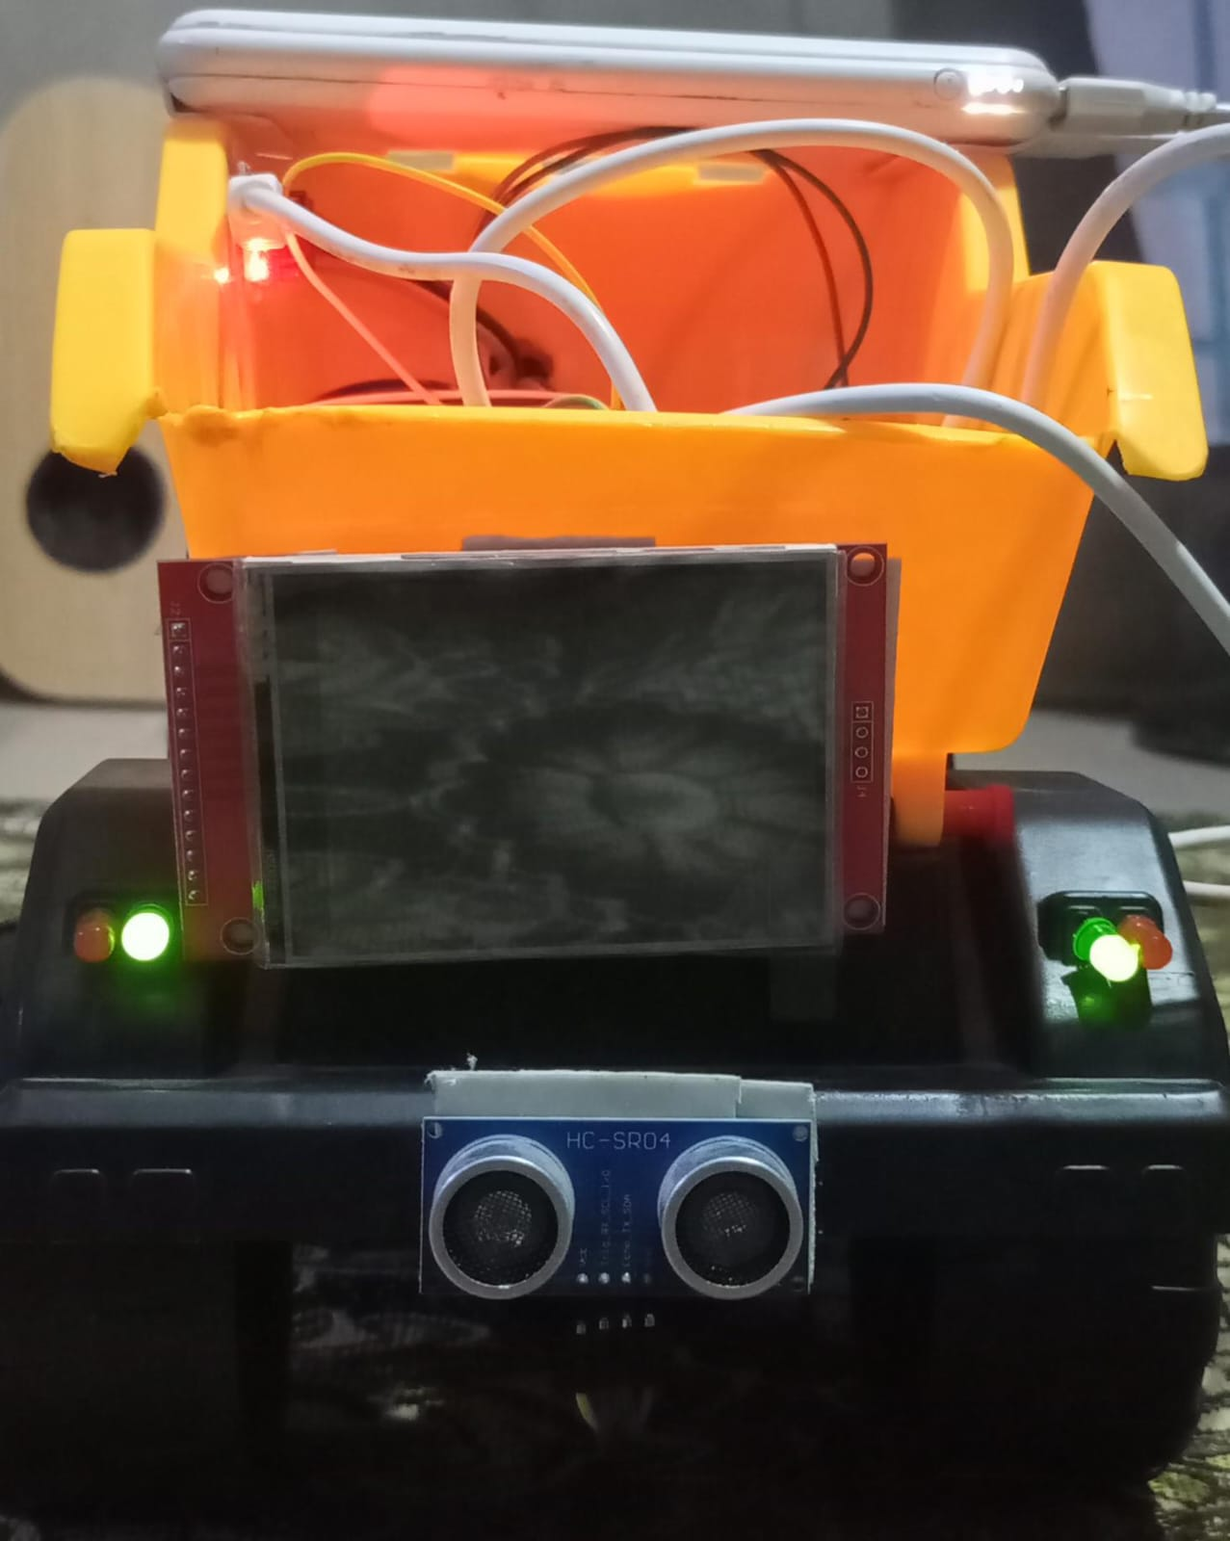
.
7
Components
LED Use for overtaking indicators.
Screen For real time video streaming captures from front camera.

Slide 22
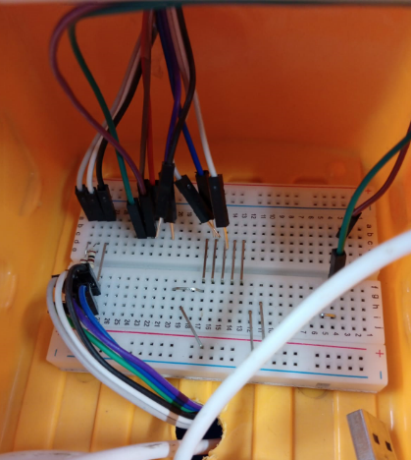
.
7
Components
Breadboard Connects ESP32-CAM, Arduino, LEDs and sensors with flexible wiring for testing.

Slide 23
.
7
Components
The Vision-Guard system prototype used low-cost components for testing:
ESP32-CAM
Arduino UNO
ESP8266 with Ultrasonic Sensors
For real-world truck deployment, automotive-grade and industrial hardware is required.

Slide 24
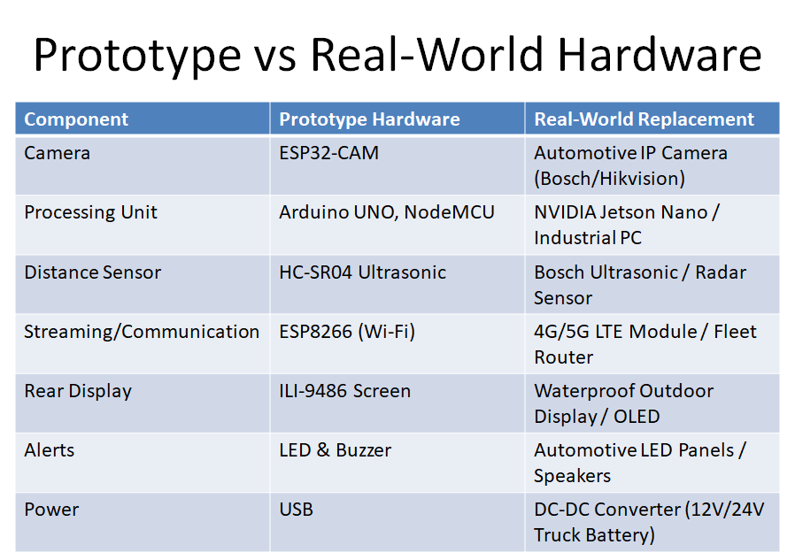
.
7
Components

Slide 25
08
Similar Applications

Slide 26
8
Similar Applications
MirrorCam System (Mercedes-Benz
Transparent Truck (Samsung)
Mobileye Shield+
Similar: Camera-based visibility improvement.
New Feature: Rear-mounted display for following vehicles.
Similar: Front camera streaming to rear display.
New Feature: Proximity detection and collision warnings.
Similar: AI and cameras for collision avoidance.
New: Highway-focused overtaking assistance.

Slide 27
09
Project Features

Slide 28
9
Project Features
ESP32-CAM → Captures front view and detects vehicles.
Arduino Uno → Manages signals and hardware control.
8-bit ILI9486 LCD → Displays live road feed on truck rear.
LED Indicators:
🟢 Green → Safe to overtake
🔴 Red → Unsafe to overtake
Web Dashboard → Shows logs and driving history
Optimized Wiring → For better stability and fewer errors.
Testing:
Conduct real-time environment testing using toy cars.
Fine-tune sensor sensitivity and response times.

Slide 29
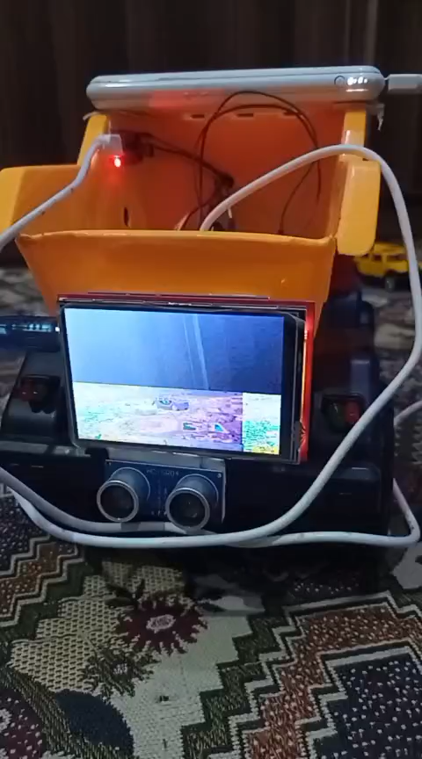
.
9
Project Features
LCD → Displays the live video stream captures from front camera.

Slide 30
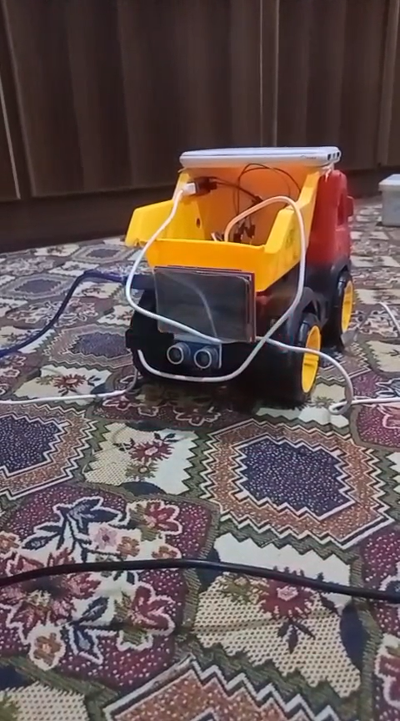
.
9
Project Features
Red LED → Not safe for overtaking distance is less than 50 cm.

Slide 31
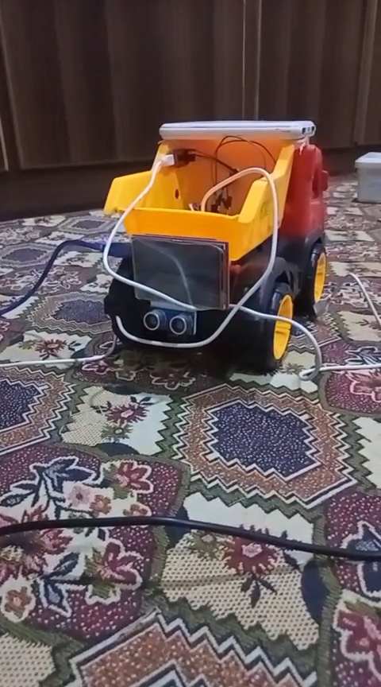
.
9
Project Features
Green LED → Safe for overtaking distance is more than 50 cm.

Slide 32

.
9
Project Features
Distance Calculation → Shows calculated distance based upon sensors.

Slide 33
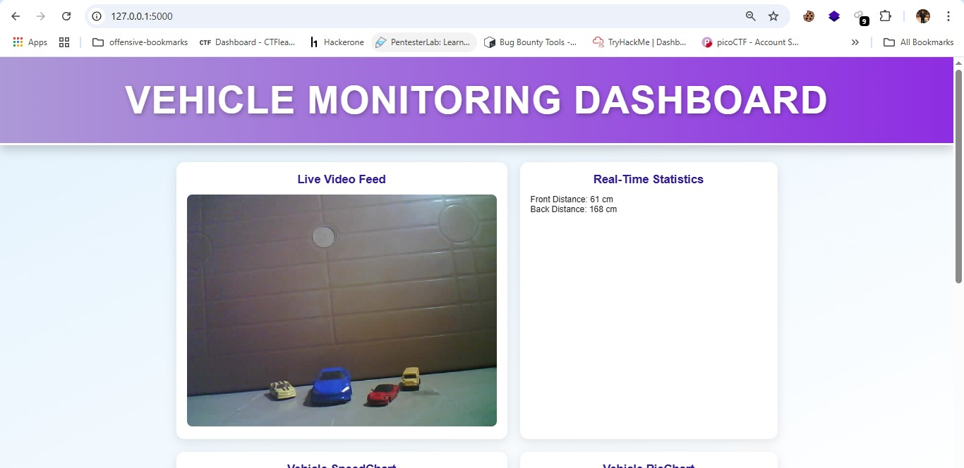
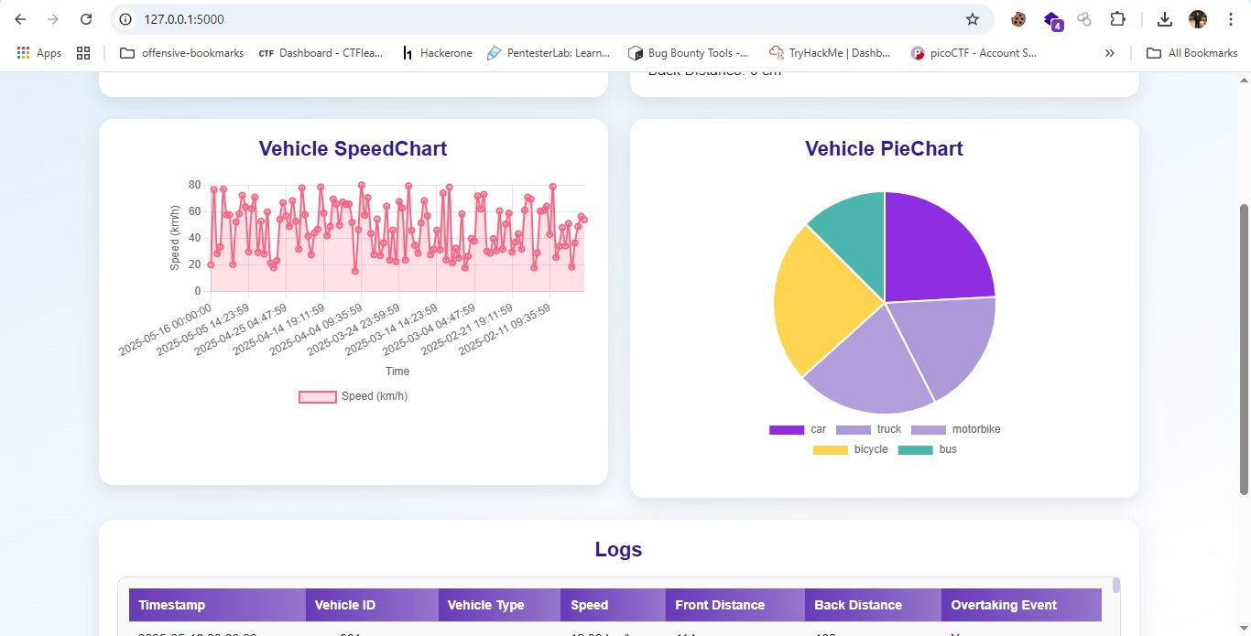
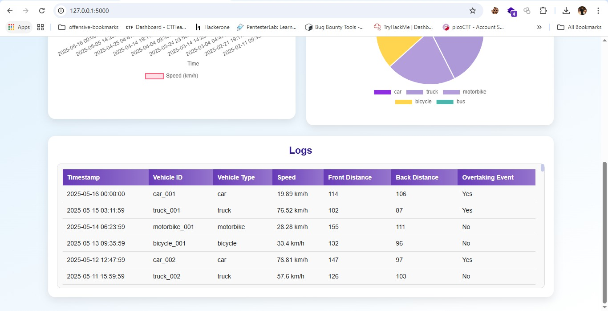
.
9
Project Features
Web dashboard → Shows calculated distance based upon sensors.

Slide 34
10
Testing & Validation

Slide 35
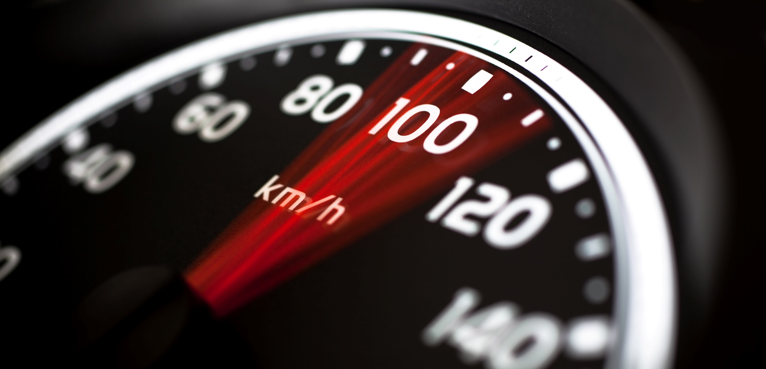
10
Testing & Validation
METRICS:
Proximity detection accuracy
LCD video stream reliability
LED alert response speed
Hardware connection stability
Web dashboard logging accuracy
LED visibility in green/red lighting.

Slide 36

Budget & Scalability
Cost-Effective Components:
Camera, Sensors, Node MCU, Buzzers, Arduino uno, LCD & LED.
Scalability:
Suitable for large-scale adoption in commercial purposes.

Slide 37
11
Work Flow

Slide 38
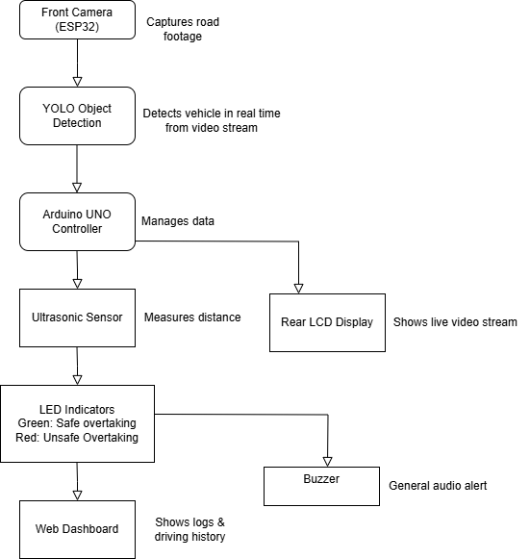
11
Work Flow
Camera captures front road footage
YOLO detects vehicles in real time
Arduino processes detection results
Ultrasonic sensor (or proximity logic) checks safe distance
Green/Red LED indicate overtaking safety
Video feed displayed on rear LCD screen
Alerts activated for collision risks
Driving data logged and shown on web dashboard

Slide 39
12
Conclusion

Slide 40

12
Conclusion
Vision-Guard enhances highway safety by tackling visibility and proximity challenges. It minimizes blind spots, improves overtaking decisions, and reduces accidents by enabling drivers to see ahead of trucks and issuing timely warnings. By using low-cost components. The system shows how simple components can work together for advanced safety. Despite a few hardware limits, the prototype works well. Vision-Guard combines innovation and affordability to create safer, making roads safer for everyone.

